Slide 1

Investigating the Validity of Fifth-Force Approximations
Joseph Egan,
PHYS40180 Research Project, Literature Review Presentation
22nd October 2026

Slide 2
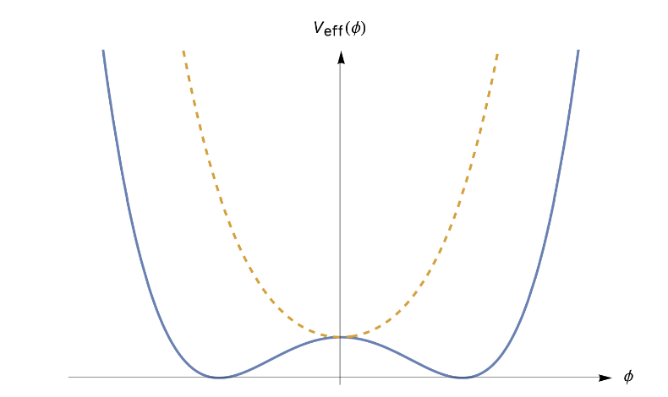
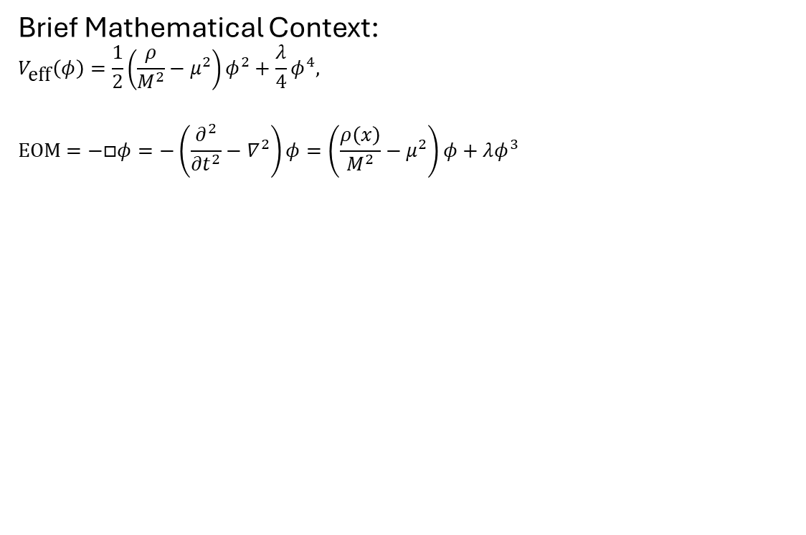
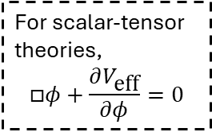
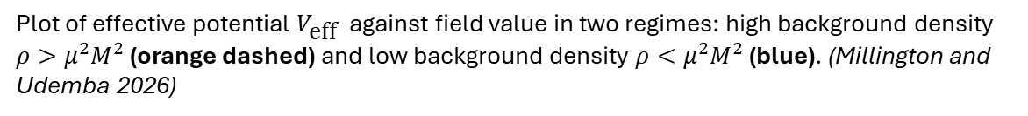
Context: Screening Mechanisms
Symmetron: A screening mechanism that allows a scalar field to mediate a long-range(∼Mpc) force of gravitational strength in the cosmos while satisfying local tests of gravity. (Hinterbichler and Khoury 2010)
Purpose:
Standard ΛCDM cosmology explains cosmic acceleration with a cosmological constant.
Possibility that cosmic acceleration is driven by a dynamical component. Light scalars are predicted by high-energy physics but are unobserved by local (within our solar system) experiments.
Bridges dark matter and modified gravity theories (Burrage, Copeland, Käding & Millington 2019)
Such scalars imply a fifth fundamental force.
A screening mechanism was proposed to justify both their existence and lack of observation.
(Burrage, Elder, Millington, Saadeh & Thrussel 2021)
Brief Mathematical Context:
$$V_{\text{eff}}\left(φ\right)=\frac{1}{2}\left(\frac{ρ}{M^{2}}−μ^{2}\right)φ^{2}+\frac{λ}{4}φ^{4},$$
$$EOM=−□φ=−\left(\frac{∂^{2}}{∂t^{2}}−∇^{2}\right)φ=\left(\frac{ρ\left(x\right)}{M^{2}}−μ^{2}\right)φ+λφ^{3}$$
For scalar-tensor theories,
$$□φ+\frac{∂V_{\text{eff}}}{∂φ}=0$$
Plot of effective potential $V_{\text{eff}}$ against field value in two regimes: high background density $ρ>μ^{2}M^{2}$ (orange dashed) and low background density $ρ<μ^{2}M^{2}$ (blue). (Millington and Udemba 2026)

Slide 3
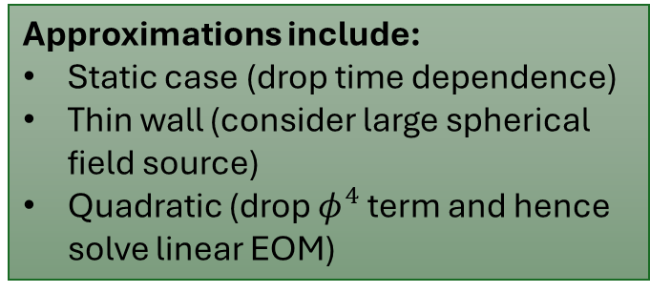
Aim: Approximate and Compare
Approximations include:
Static case (drop time dependence)
Thin wall (consider large spherical field source)
Quadratic (drop $φ^{4}$ term and hence solve linear EOM)
Objective
Apply approximations to the symmetron equation of motion
Compare to more complete (numerical) calculations
Quantify the error introduced with respect to these approximations
Is there an optimal approximation or combination of them which closely aligns with numerical results?
Possibly provide a more convenient analytical framework for symmetron, reducing the need for numerical simulations
State-of-the-Art
Since its recent proposal in 2010, many experiments have been performed to constrain the field parameters.
(Burrage, Copeland and Hinds 2015; Chiow and Yu 2020; Sabulsky et al. 2019; Brax, Davis, Elder and Wong 2018; Yin et al. 2025; Fischer, Käding and Pitschmann 2024)
Recently: Quantum corrections have been applied to the classical symmetron field.
Impact within symmetron research: Quantum corrections become significant when considering coupling to Standard Model and the method employed to find these corrections have application to other symmetron-like models (Millington and Udemba 2026)
Potential Societal Impact
Development of new computational tools, with practical application in other fields (Fischer and Sedmik 2024):
  Gravity resonance spectroscopy
  Lunar Laser Ranging
  Casimir and Non-Newtonian Force Experiment
Improvement of existing experimental techniques, i.e. cold atom interferometry (Burrage, Kuribayashi-Coleman, Stevenson & Thrussel 2016)
The latter can lead to improvements in high-precision clocks (Feleppa, Lambiase & Vagnozzi 2025)

Slide 4
References
Philippe Brax and Mario Pitschmann. “Exact solutions to nonlinear symmetron theory: One- and two-mirror systems”. In:Physical Review D 97.6 (Mar. 2018). issn: 2470-0029. doi: 10.1103/physrevd.97.064015. url: http://dx.doi.org/10.1103/PhysRevD.97.064015.
Clare Burrage, Edmund J. Copeland, and E.A. Hinds. “Probing dark energy with atom interferometry”. In: Journal of Cosmologyand Astroparticle Physics 2015.03 (Mar. 2015), pp. 042–042. issn: 1475-7516. doi: 10.1088/1475-7516/2015/03/042. url:http://dx.doi.org/10.1088/1475-7516/2015/03/042.
Clare Burrage et al. “Constraining symmetron fields with atom interferometry”. In: Journal of Cosmology and AstroparticlePhysics 2016.12 (Dec. 2016), pp. 041–041. issn: 1475-7516. doi: 10.1088/1475-7516/2016/12/041. url: http://dx.doi.org/10.1088/1475-7516/2016/12/041.
Clare Burrage et al. “Fifth-force screening around extremely compact sources”. In: Journal of Cosmology and AstroparticlePhysics 2021.08 (Aug. 2021), p. 052. issn: 1475-7516. doi: 10.1088/1475-7516/2021/08/052. url: http://dx.doi.org/10.1088/1475-7516/2021/08/052.
Clare Burrage et al. “Symmetron scalar fields: Modified gravity, dark matter, or both?” In: Phys. Rev. D 99 (4 Feb. 2019),p. 043539. doi: 10.1103/PhysRevD.99.043539. url: https://link.aps.org/doi/10.1103/PhysRevD.99.043539.
Sheng-wey Chiow and Nan Yu. “Constraining symmetron dark energy using atom interferometry”. In: Physical Review D 101.8(Apr. 2020). issn: 2470-0029. doi: 10.1103/physrevd.101.083501. url: http://dx.doi.org/10.1103/PhysRevD.101.083501.
Fabiano Feleppa, Gaetano Lambiase, and Sunny Vagnozzi. “Imprints of screened dark energy on nonlocal quantum correlations”.In: Phys. Rev. D 112 (8 Oct. 2025), p. 084011. doi: 10.1103/y314-4x4s. url: https://link.aps.org/doi/10.1103/y314-4x4s.
Hauke Fischer, Christian K¨ading, and Mario Pitschmann. “Screened Scalar Fields in the Laboratory and the Solar System”.In: Universe 10.7 (2024), p. 297. issn: 2218-1997. doi: 10.3390/universe10070297. url: http://dx.doi.org/10.3390/universe10070297.
Hauke Fischer and Ren´e I.P. Sedmik. “Numerical methods for scalar field dark energy in tabletop experiments and Lunar LaserRanging”. In: Journal of Cosmology and Astroparticle Physics 2024.10 (Oct. 2024), p. 026. doi: 10.1088/1475-7516/2024/10/026. url: https://doi.org/10.1088/1475-7516/2024/10/026.
Kurt Hinterbichler and Justin Khoury. “Screening Long-Range Forces through Local Symmetry Restoration”. In: Phys. Rev.Lett. 104 (23 June 2010), p. 231301. doi: 10.1103/PhysRevLett.104.231301. url: https://link.aps.org/doi/10.1103/PhysRevLett.104.231301.
Peter Millington and Michael Udemba. “Quantum corrections to symmetron fifth-force profiles”. In: Journal of Cosmology andAstroparticle Physics 2026.02 (Feb. 2026), p. 087. doi: 10.1088/1475-7516/2026/02/087. url: https://doi.org/10.1088/1475-7516/2026/02/087.
D. O. Sabulsky et al. “Experiment to Detect Dark Energy Forces Using Atom Interferometry”. In: Physical Review Letters 123.6(Aug. 2019). issn: 1079-7114. doi: 10.1103/physrevlett.123.061102. url: http://dx.doi.org/10.1103/PhysRevLett.123.061102.
Peiran Yin et al. “Experimental constraints on the symmetron field with a magnetically levitated force sensor”. In: NatureAstron. 9.4 (2025), pp. 598–607. doi: 10.1038/s41550-024-02465-8.

